Slide 1

ACE

Slide 2
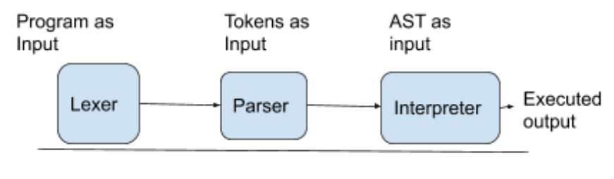
Life cycle of a program in ACE

Slide 3
Lexer
Parser
The Lexer accepts an input program and recognises all the predefined tokens in it and generates the list of tokens. We used lex to implement the lexer in our language
Parser: docstring is used, somewhat unusually, to bind grammar rules to functions. The effects of reductions can be described very conveniently in the function body. An Abstract Syntax Tree will be produced using Yacc as a tuple. YACC uses LALR(Look Ahead Left-Right) parsing technique which is a bottom-up approach.

Slide 4
Interpreter
Interpreter: The Environment changes are maintained using a Dictionary to lookup and update the variables. Another dictionary is used to maintain to lookup for functions declared by the user.

Slide 5
Operators
Operators: ACE supports the following operators:-
arithmetic operators (+,-,*,/,%)
supports relational operators (>,<,<=,>=,==,!=)
logical operators (|| , && , ! )
unary operators (++, --)

Slide 6
Data Types
ACE supports int, bool and string data types. You don’t need to put data types while declaring the variable. The compiler will dynamically recognize the data type.
ex: var x = 0, var y = “team23”, var h = true

Slide 7
Conditional Statement
ACE supports both traditional if and else statement and ternary operator.
Example for if in ace:
if x>0 {
x = x+1
}
Example for ternary operator in ace:
-> var x = (x>0) ? ( 1 : 0 )

Slide 8
Loops
ACE supports while, traditional for loop and for loop with range.
Example for while in ace :
While x>0 {
x = x +2
}
Example for for loop in ace:
For (var x = 0, x<10,x++){
out(x)
}
For i in range(0 , 5){
out(i)
}

Slide 9
Functions
ACE supports function declaration at the top of the program.
ex: fun add(x,y){
send x+y
}
var x = add(3,2);

Slide 10
Grammar
K=Block
S=String
N = Number
IDENT = IDENTIFIER
1)Program ::= FUNCTIONLIST K
2) FUNCTIONLIST ::= F FUNCTIONLIST | empty
3)F::= fun IDENT ( Arg ) { K send B } |
fun IDENT ( Arg) { K }
4)Arg::= IDENT , Arg
5)Arg::= IDENT | empty
6)K ::= Statements K | statements
7)Statements ::= DECLARATION ;| INITIALIZATION ;| ASSIGN ;| IF | While | FOR |
Print ; | UNARY | FUNCALL;

Slide 11
8)DECLARATION::= var IDENT
9)INITIALIZATION::= var IDENT = B
10)ASSIGN::= IDENT= B
11)UNARY ::= IDENT ++ | IDENT --
12) FUNCALL::= IDENT ( Arg )
13)IF::= if B { K } ELIF
14)ELIF::= elif B { K } ELIF
15)ELIF::=else { K }
16)ELIF::= empty
17) While::=while B { K }

Slide 12
18)FOR::= for ( INITIALIZATION , B , ASSIGN ) { K } |
for ( INITIALIZATION , B , UNARY ) { K } |
for IDENT in range ( E , E ) { K }
19)B ::= true | false | not B | CONDITION | B or B | B and B | E
20)C ::= E < E | E > E | E<= E | E >= E | E == E | E != E
21)E ::= E + E | E - E | E * E | E / E | IDENT | N | S | TERNARY | FUNCALL
22)IDENT ::= [A-Z] IDENT1
23)IDENT1 ::= [A-Z] | [0 - 9] | empty
24)N::= D N
25)N::= D
26)D ::= [0-9]
27) TERNARY::= ( B ) ? ( B : B )

Slide 13
22)IDENT ::= [A-Z] IDENT1
23)IDENT1 ::= [A-Z] | [0 - 9] | empty
24)N::= D N
25)N::= D
26)D ::= [0-9]
27) TERNARY::= ( B ) ? ( B : B )

Slide 14
Features of ACE
ACE supports functions with return statement and without return.
ACE also supports function recursion.
Return type functions can be used in expression and boolean.
Ternary operator can also be used in expressions and boolean.
ACE supports string concatenation with ‘+’ operator and comparing string with
‘==’ and ‘!=’ operator

Slide 15
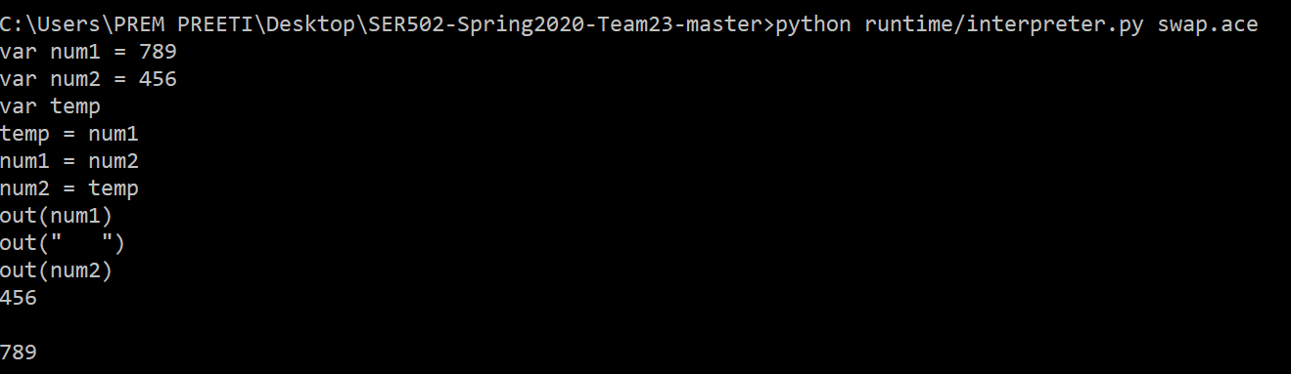
Some example programs in ACE :
1.Swapping of two integers using a temp variable

Slide 16
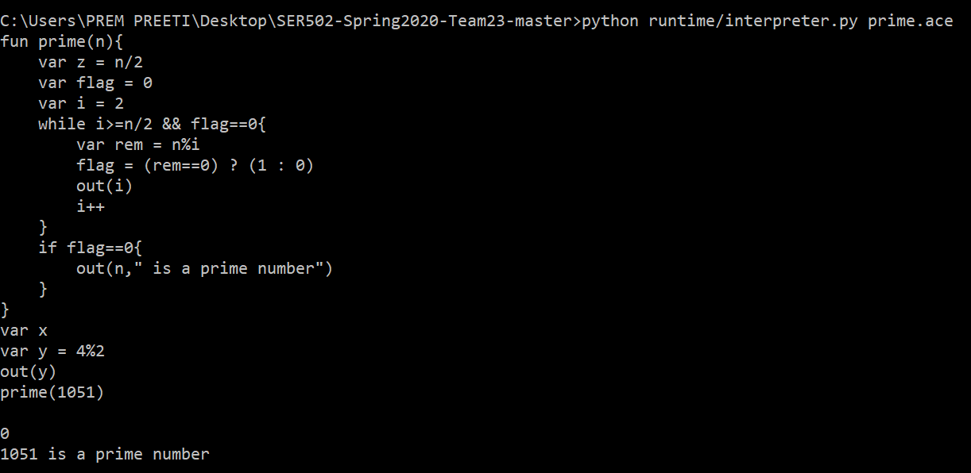
2. Checking whether the given integer is prime or not

Slide 17
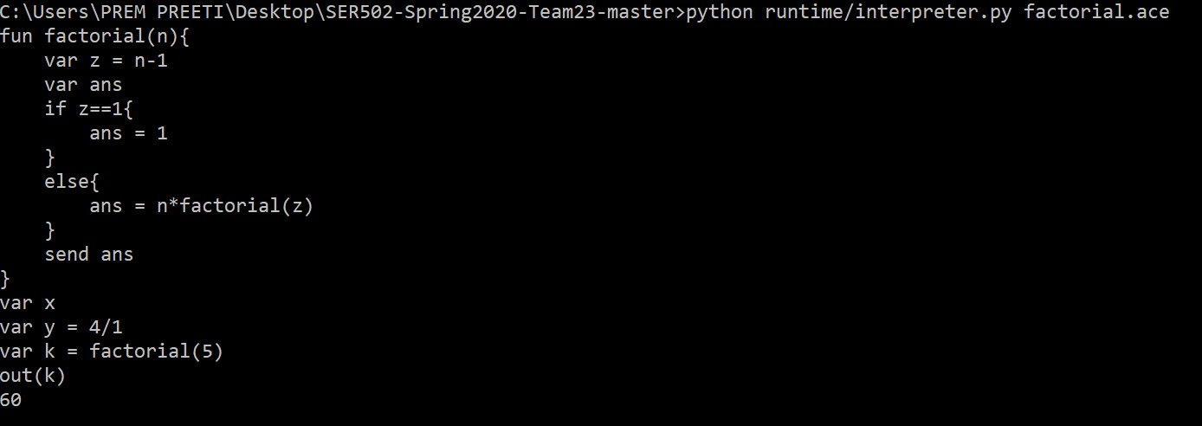
3. Finding the factorial of a number

Slide 18
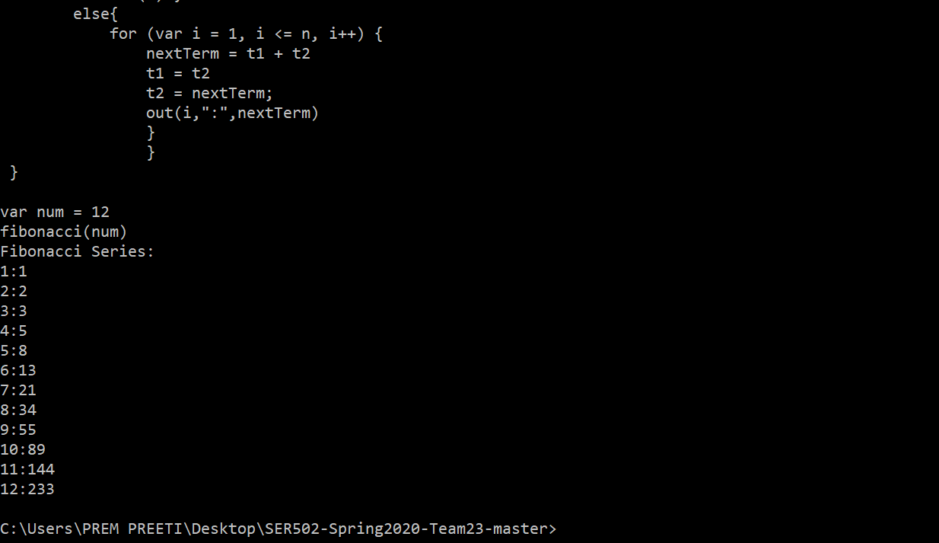
4.Fibonacci series

Slide 19
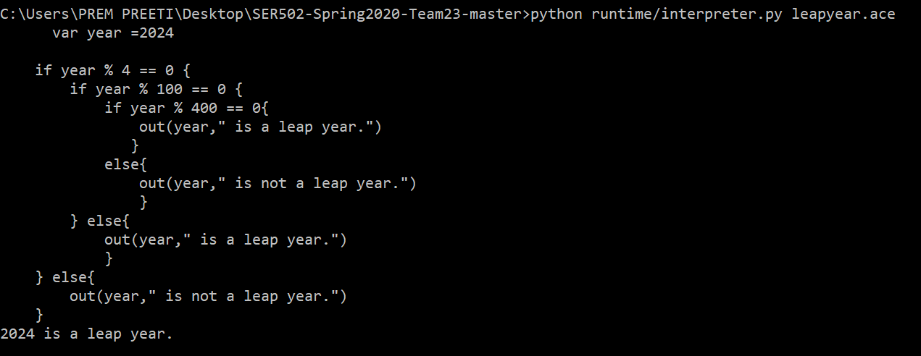
5. Checking whether the given year is leap year or not

Slide 20
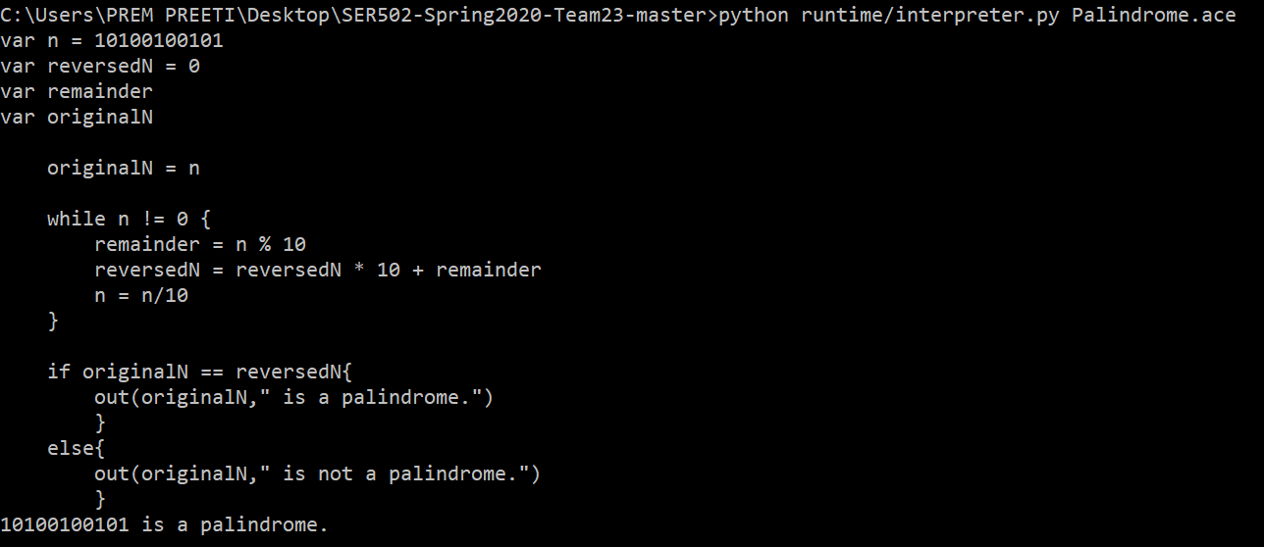
6. Checking whether the given number is a Palindrome or not

Slide 21
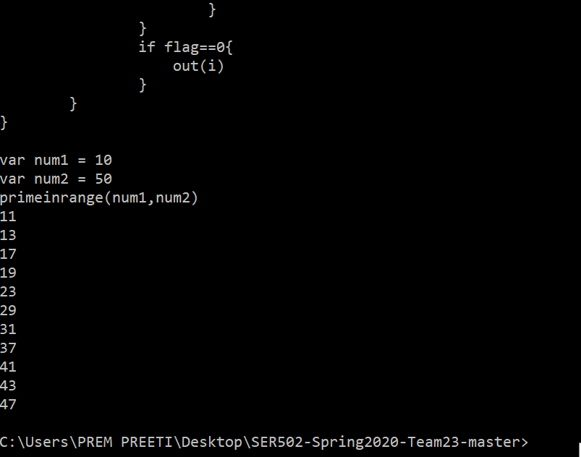
7. Printing Prime numbers in the given range

Slide 22
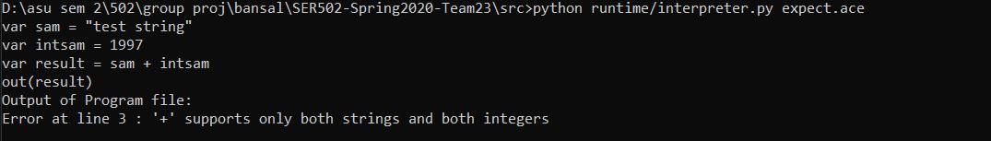
An error statement shown by ace

Slide 23
